Slide 1

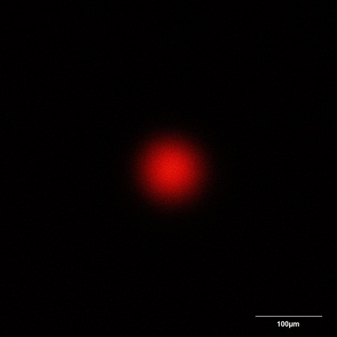
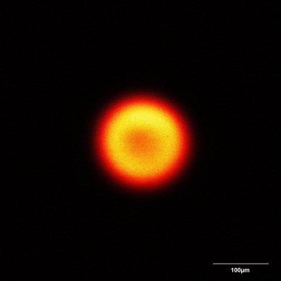
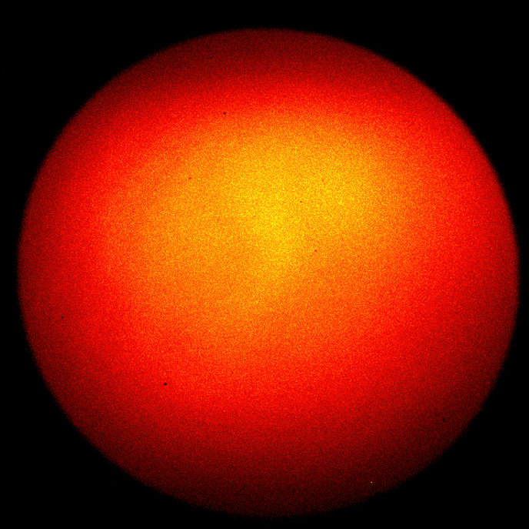
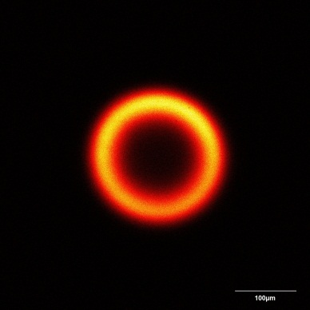
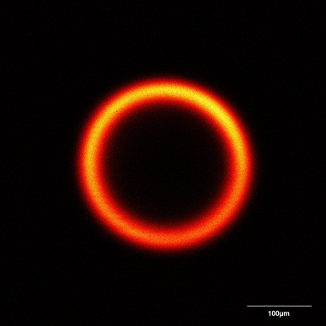
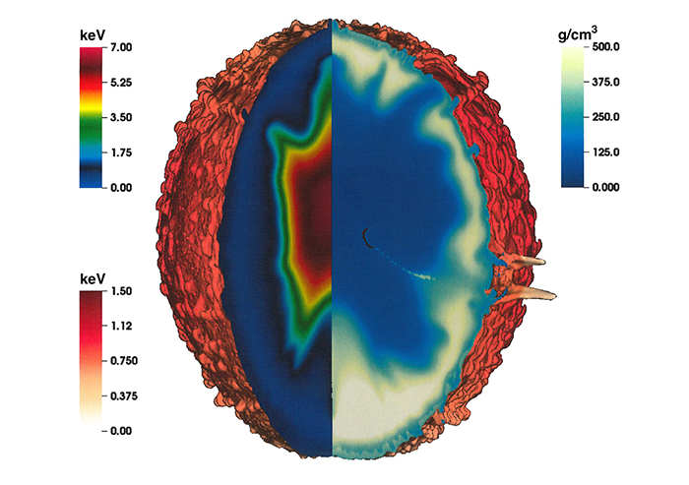
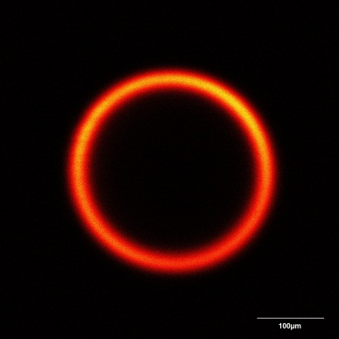
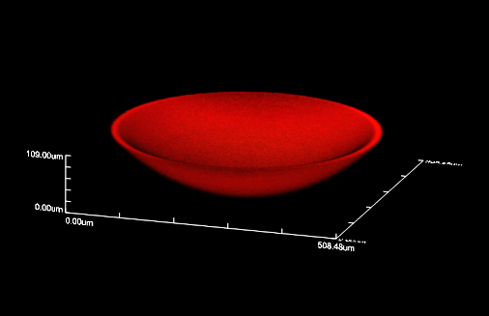
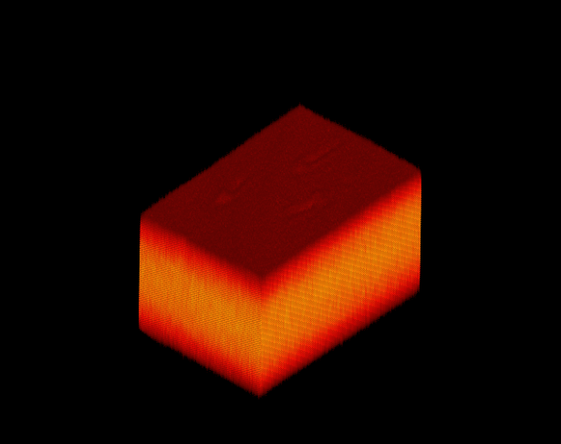
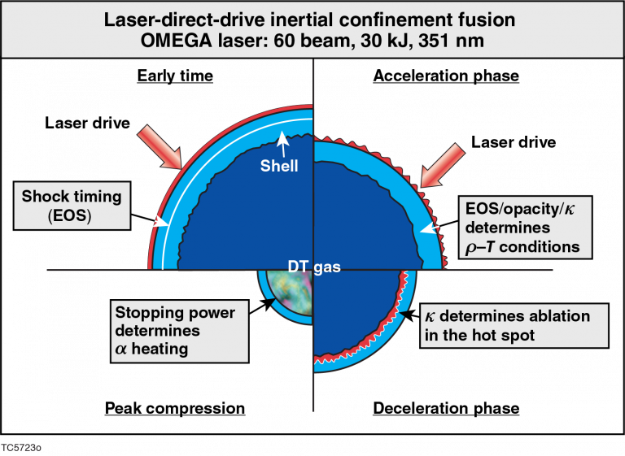
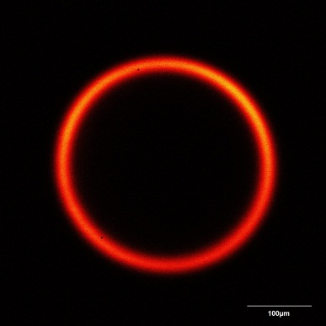
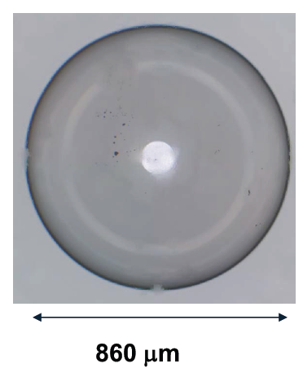
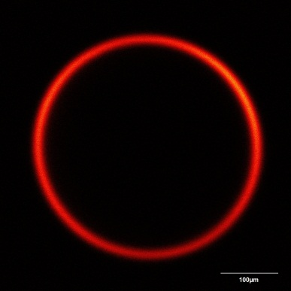
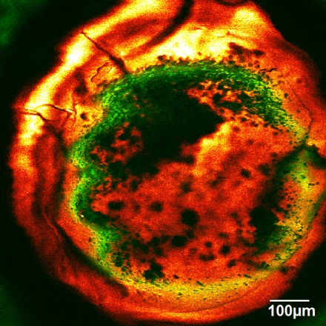
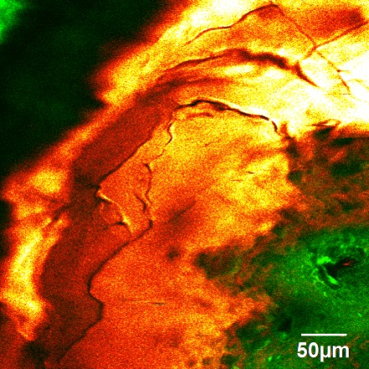
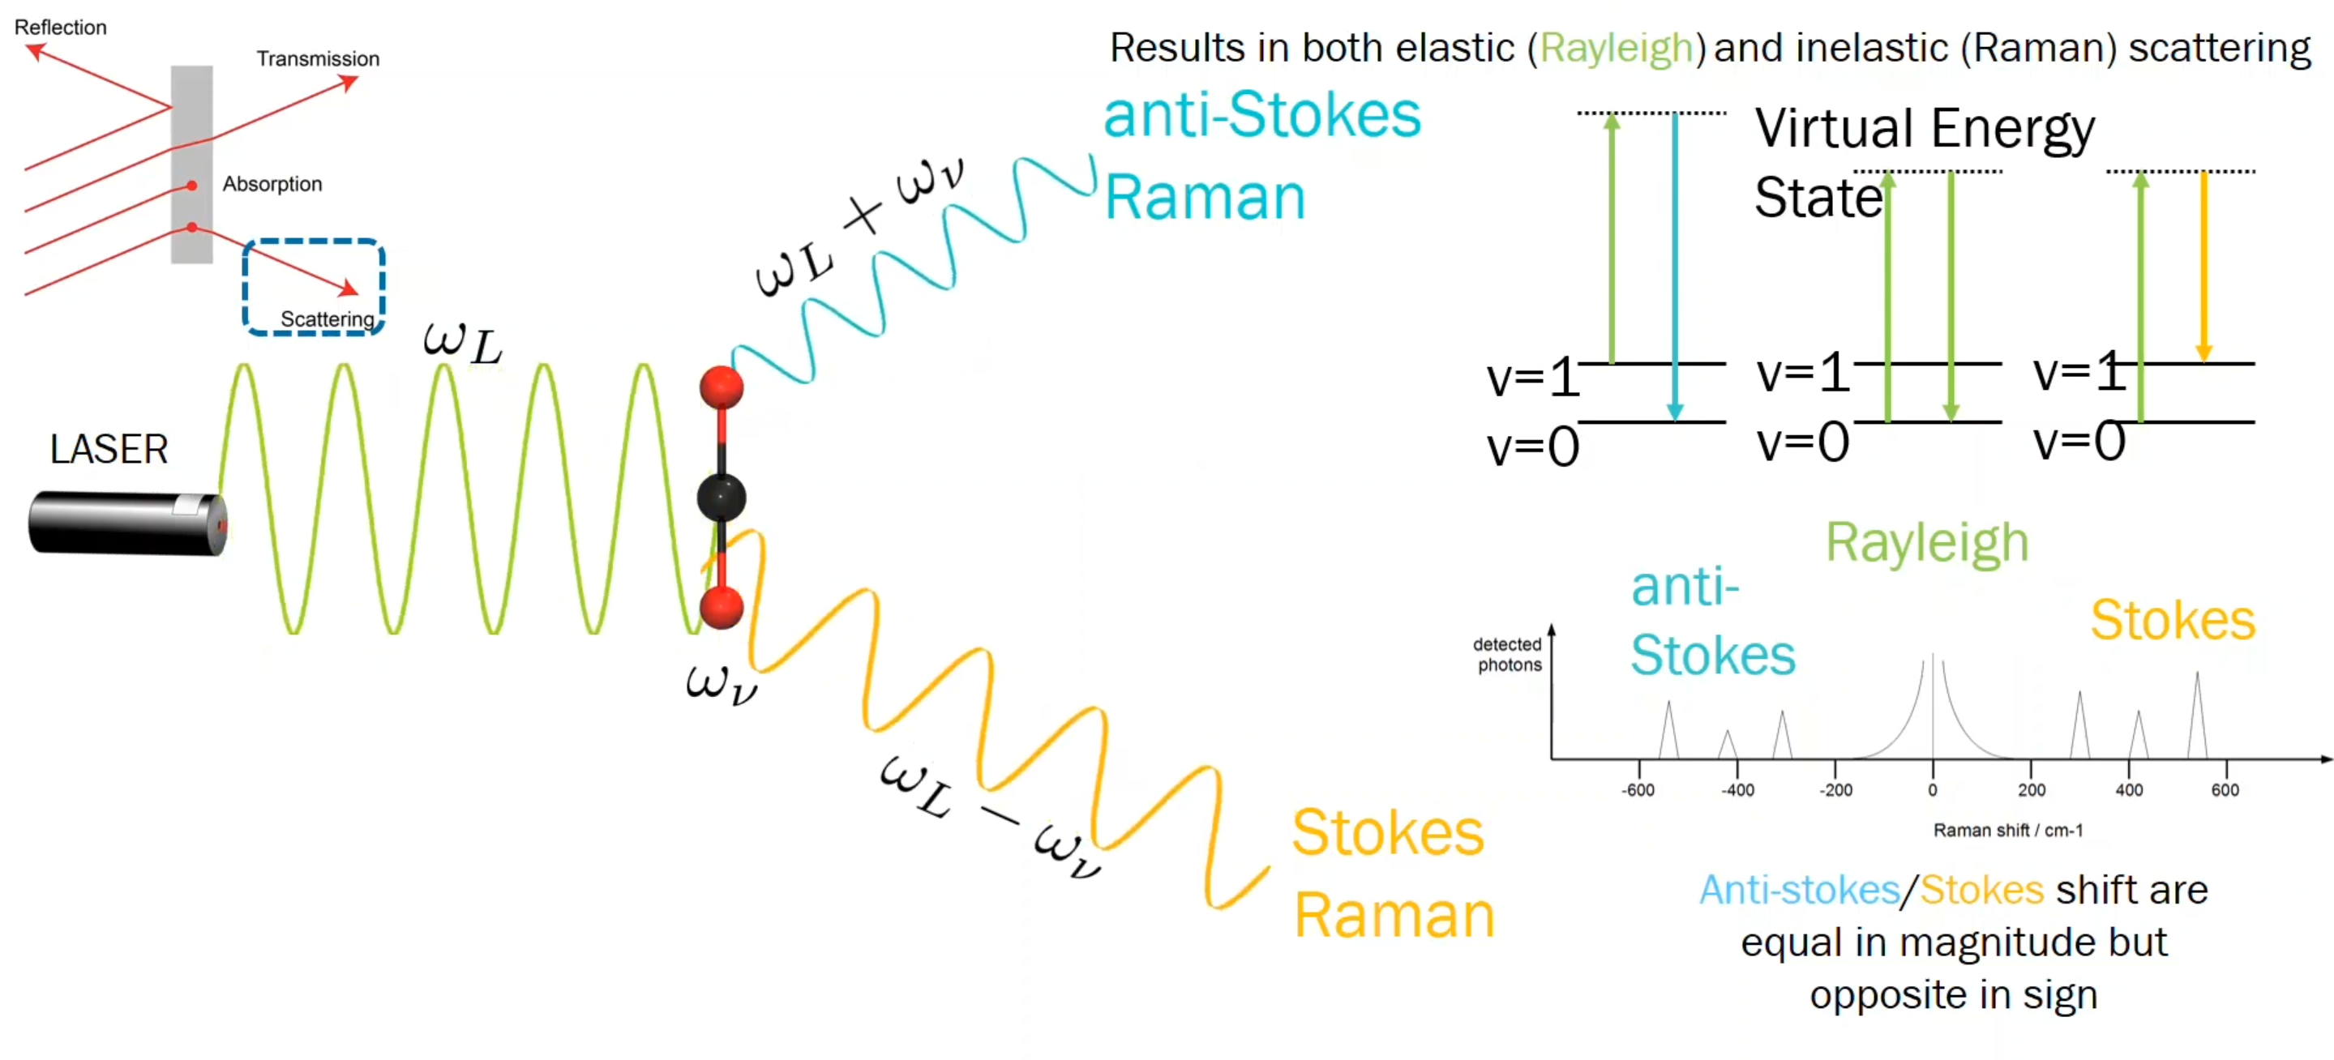
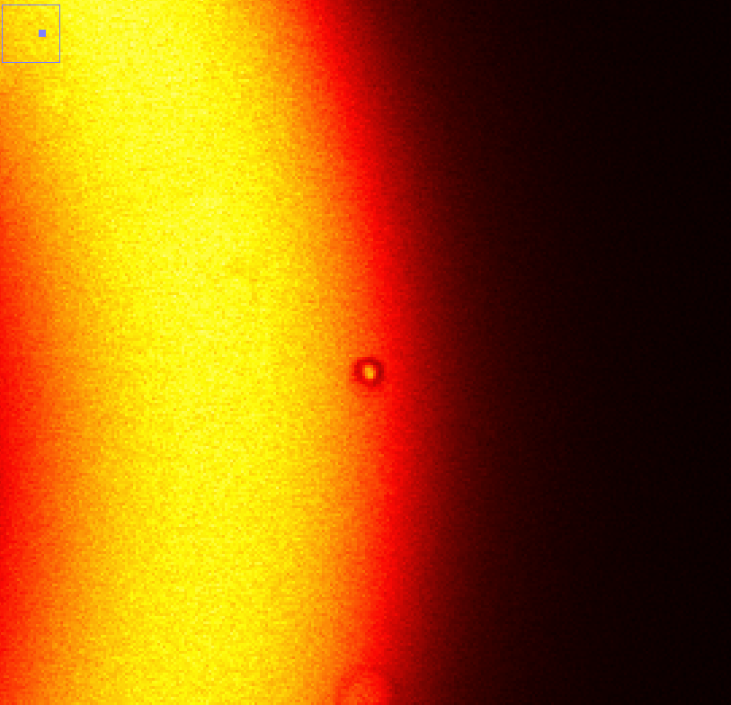
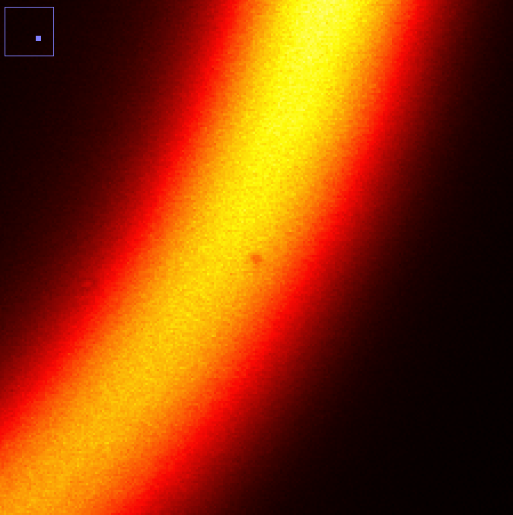
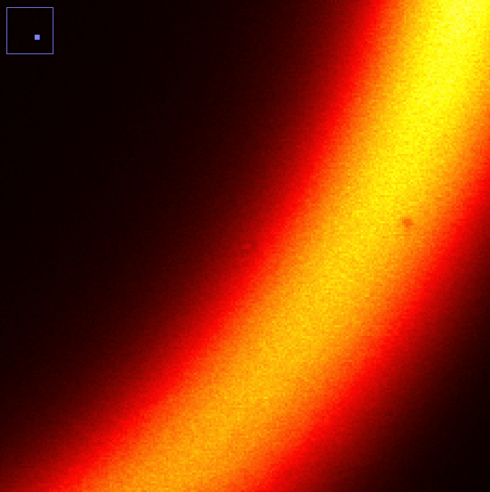
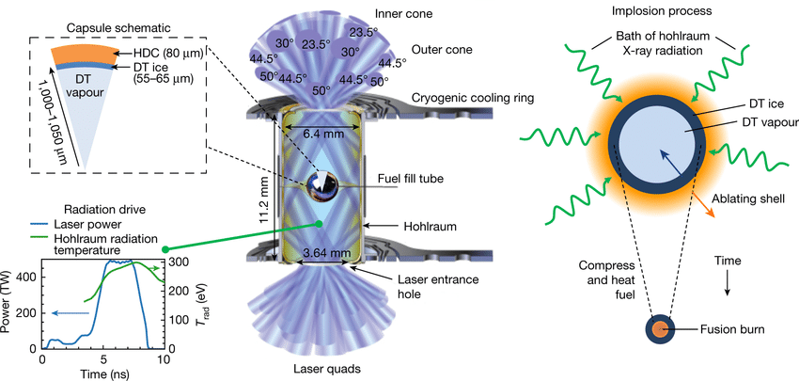
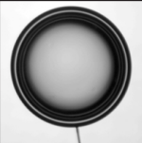
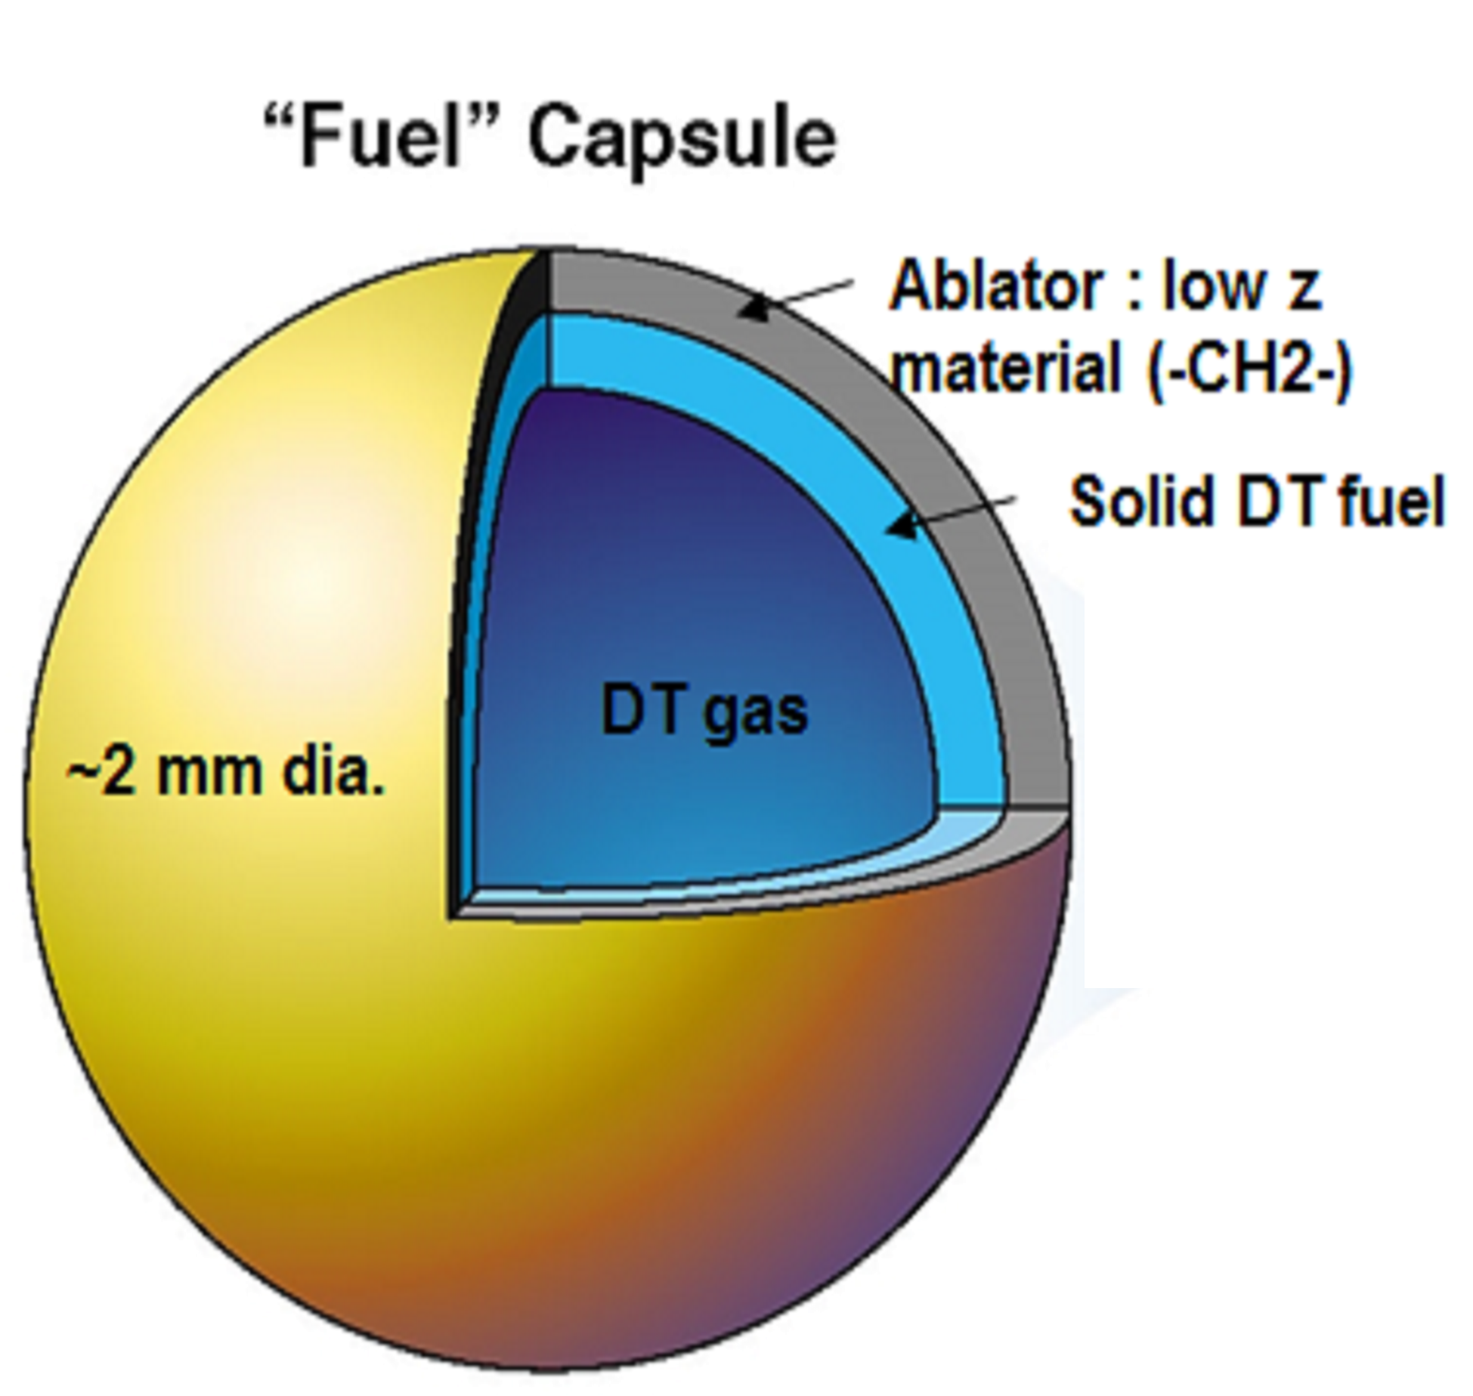
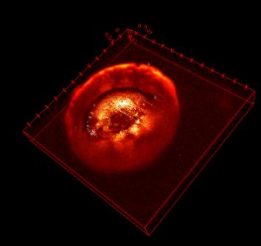
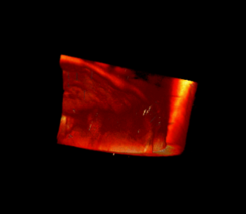
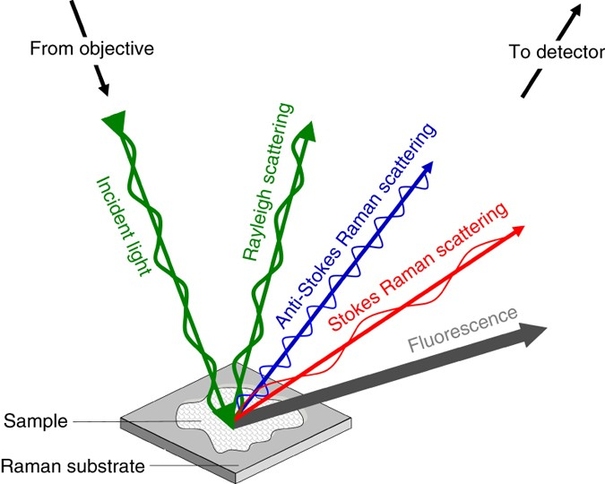
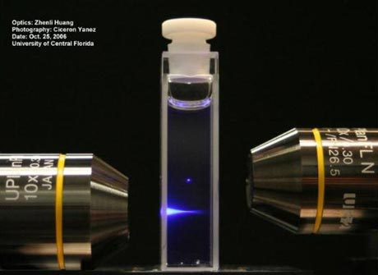
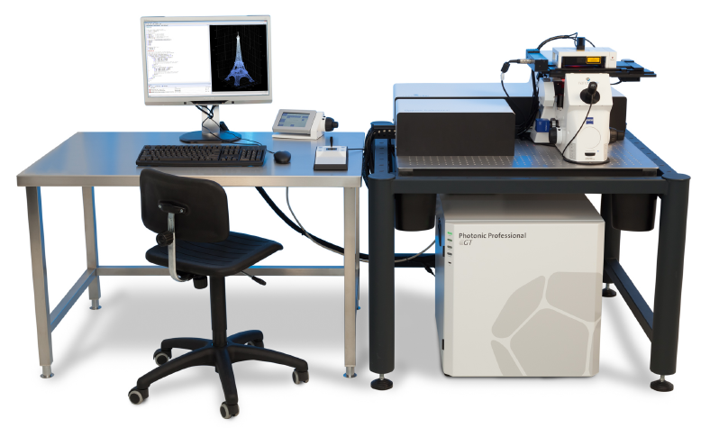
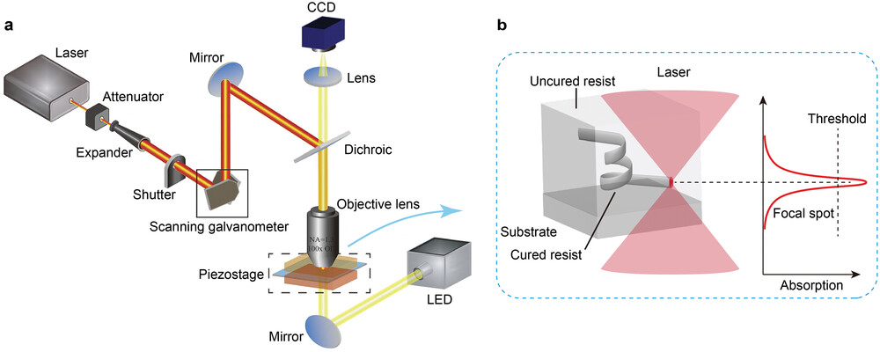
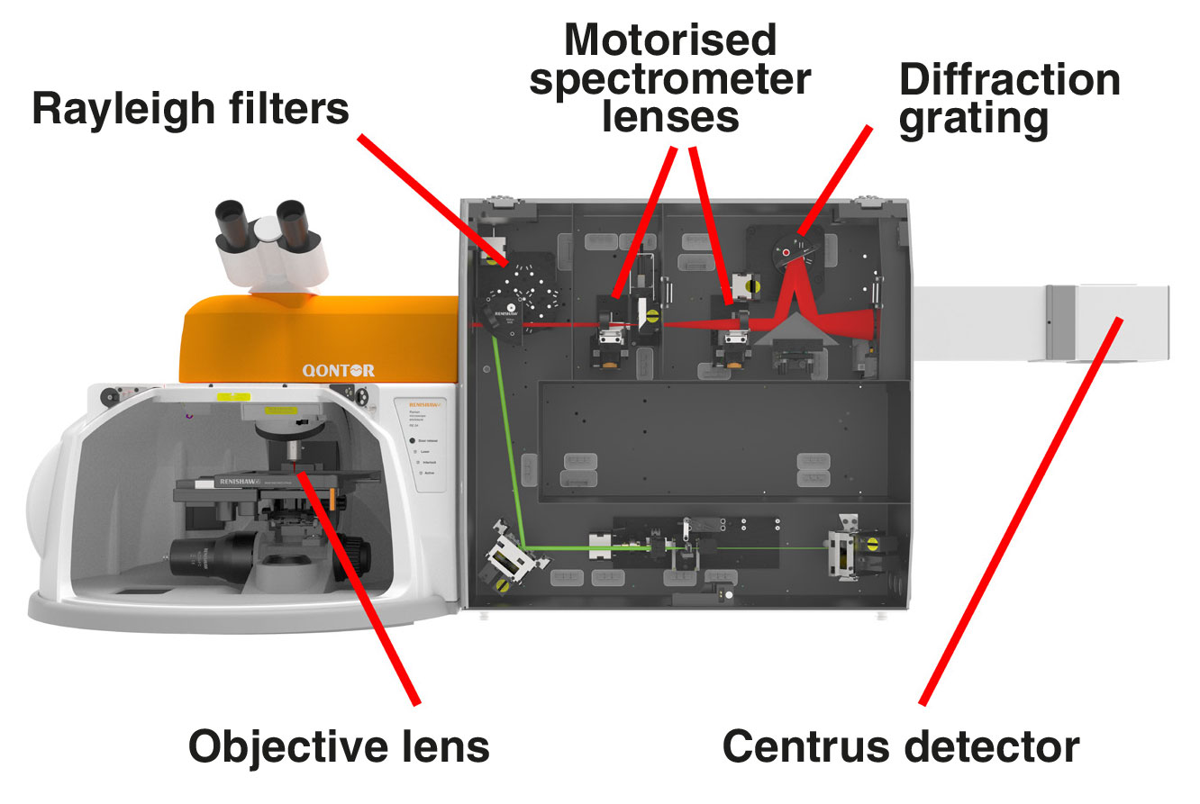
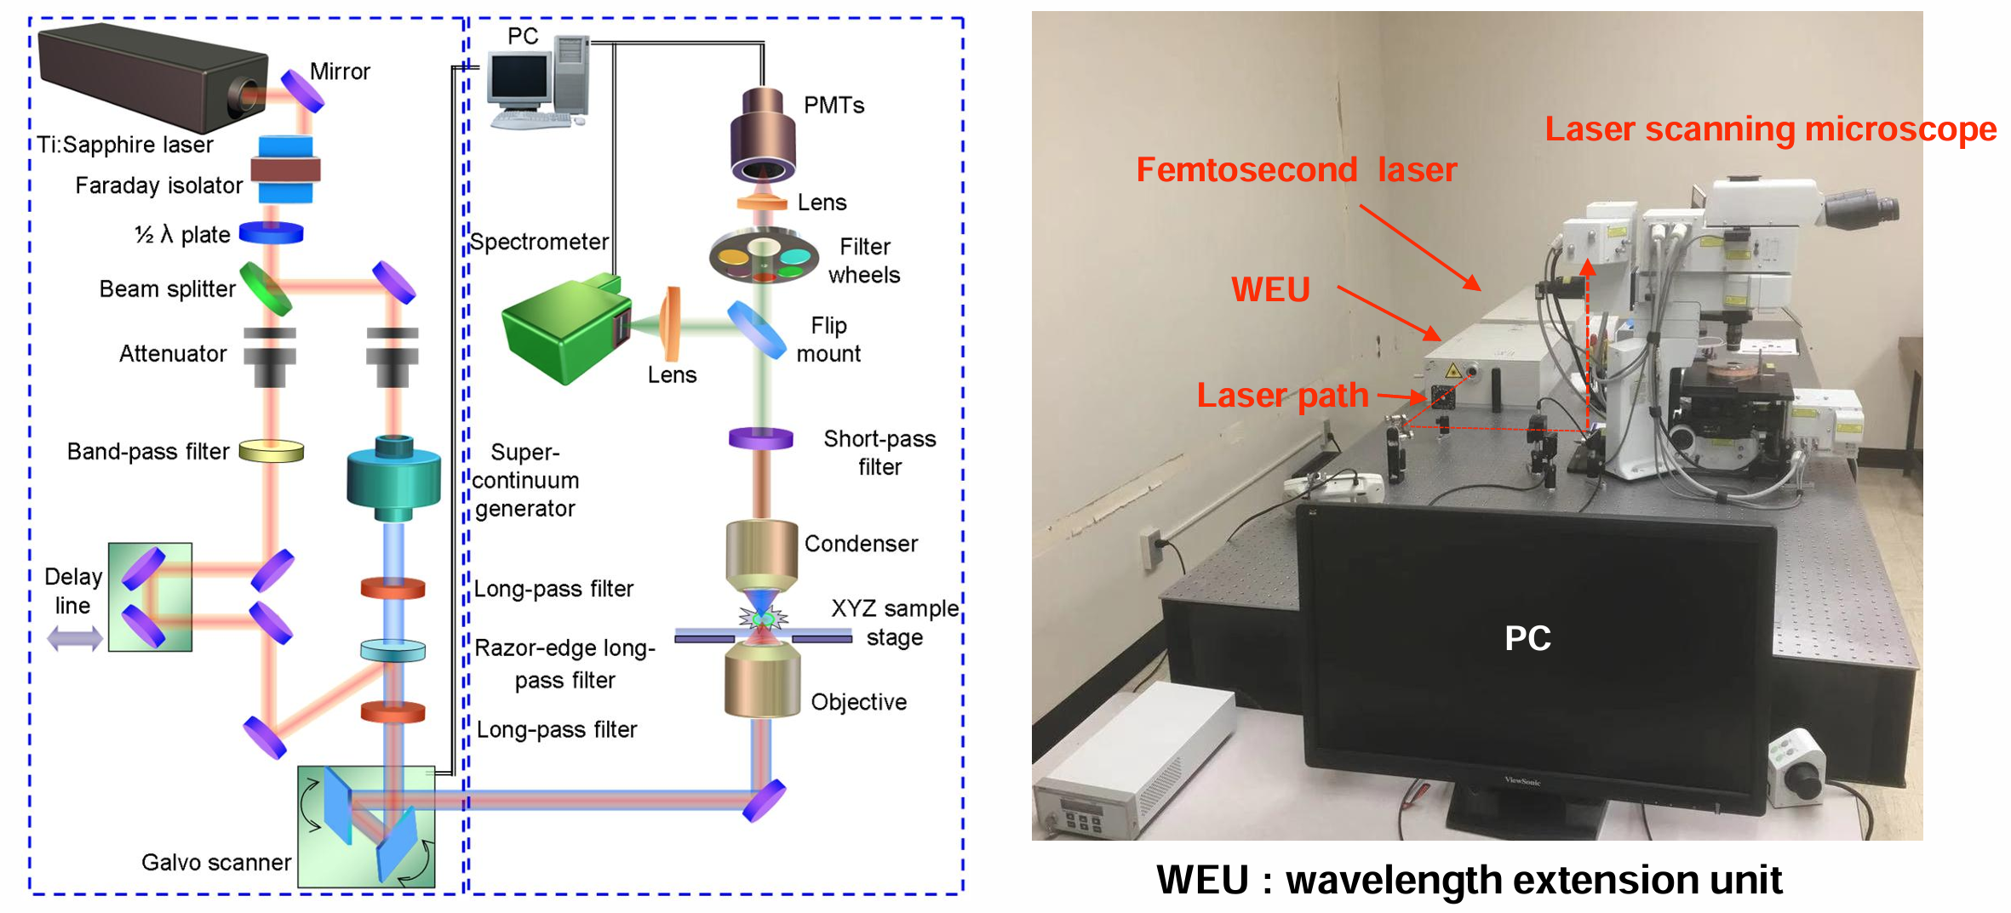
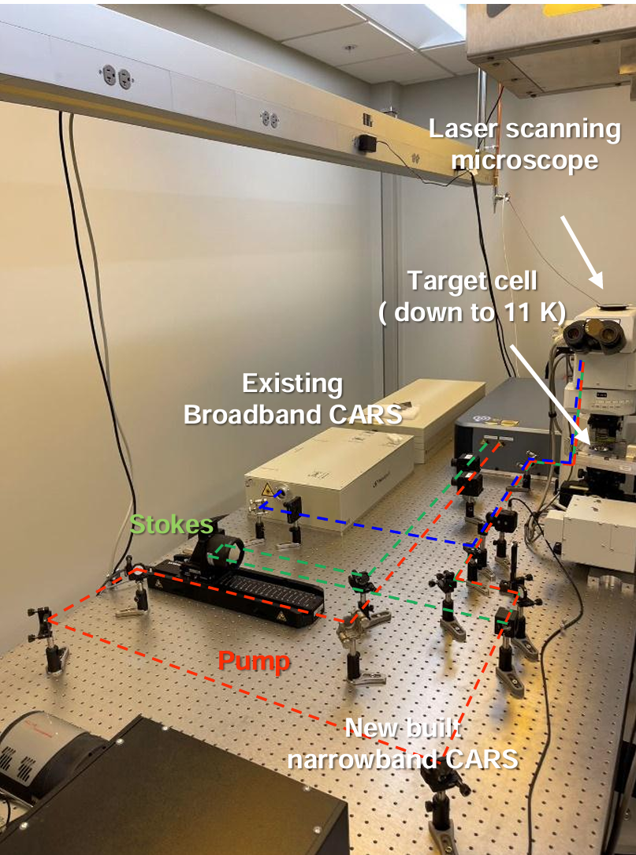
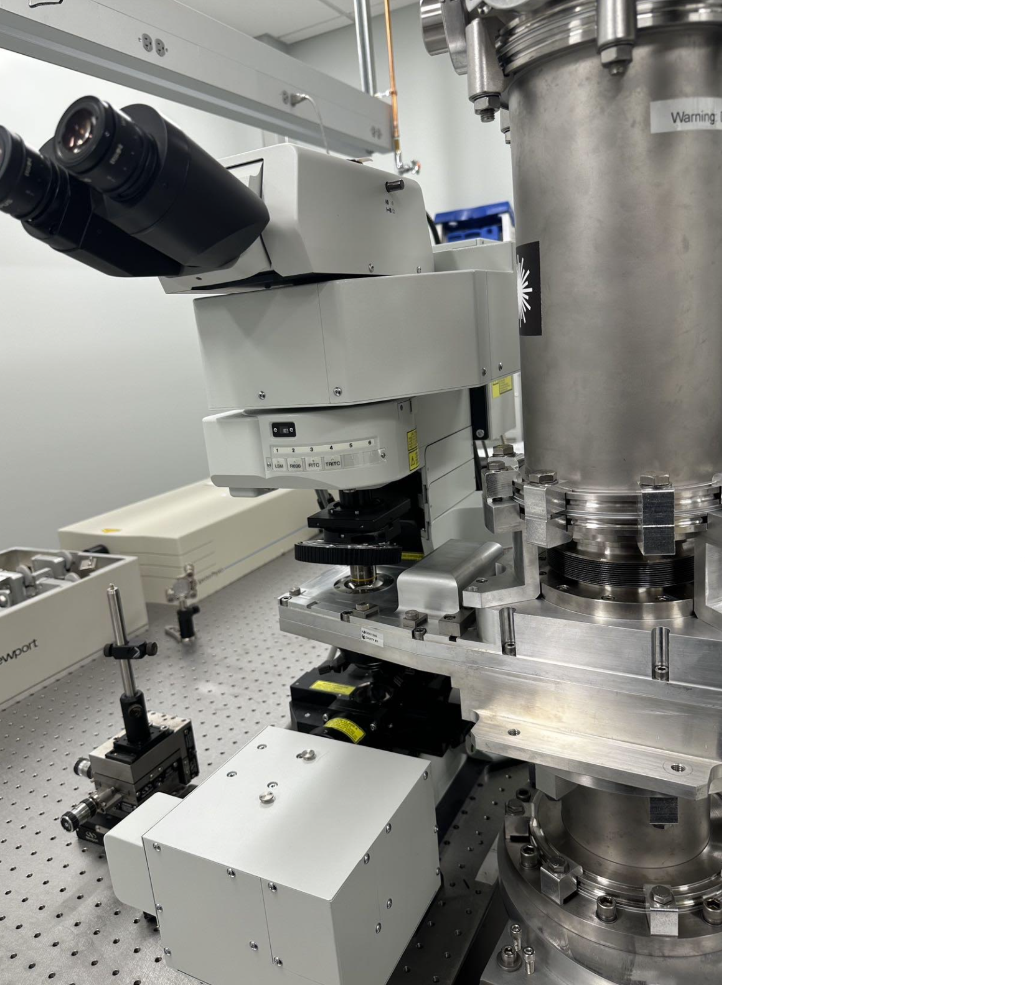
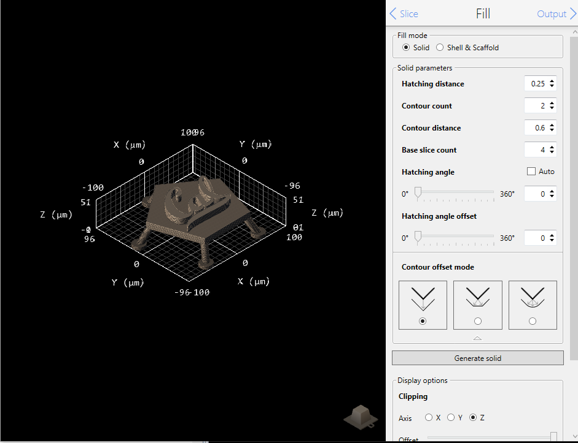
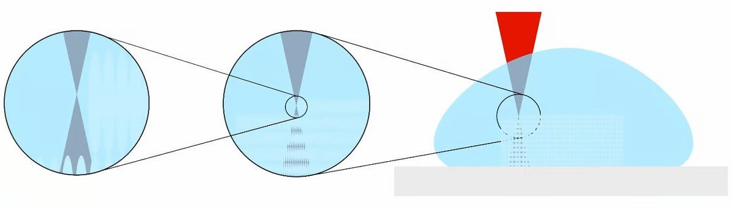
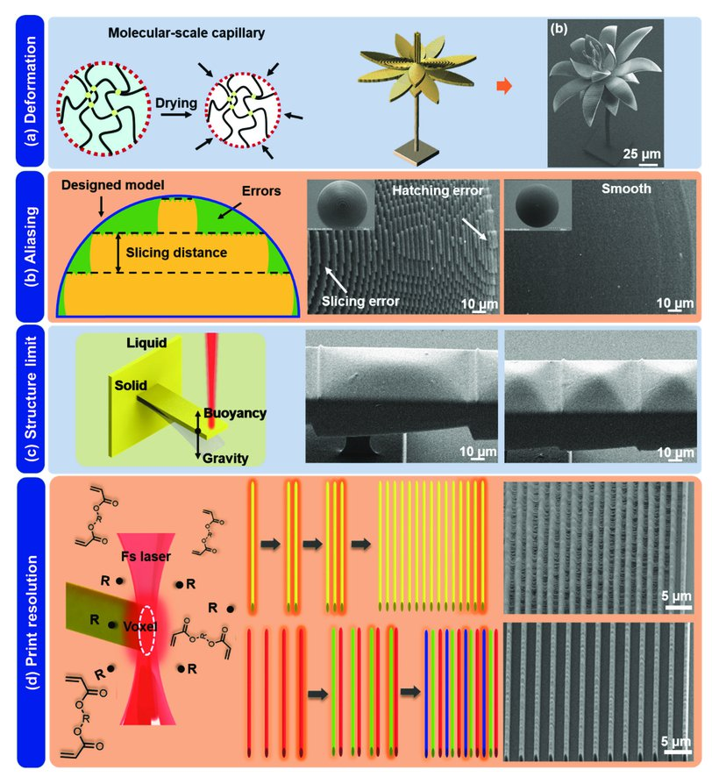
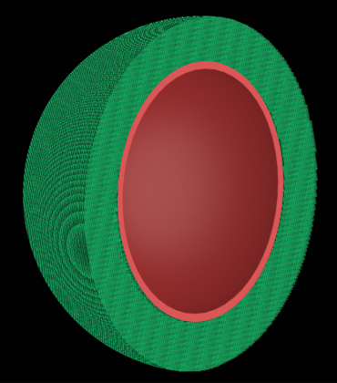
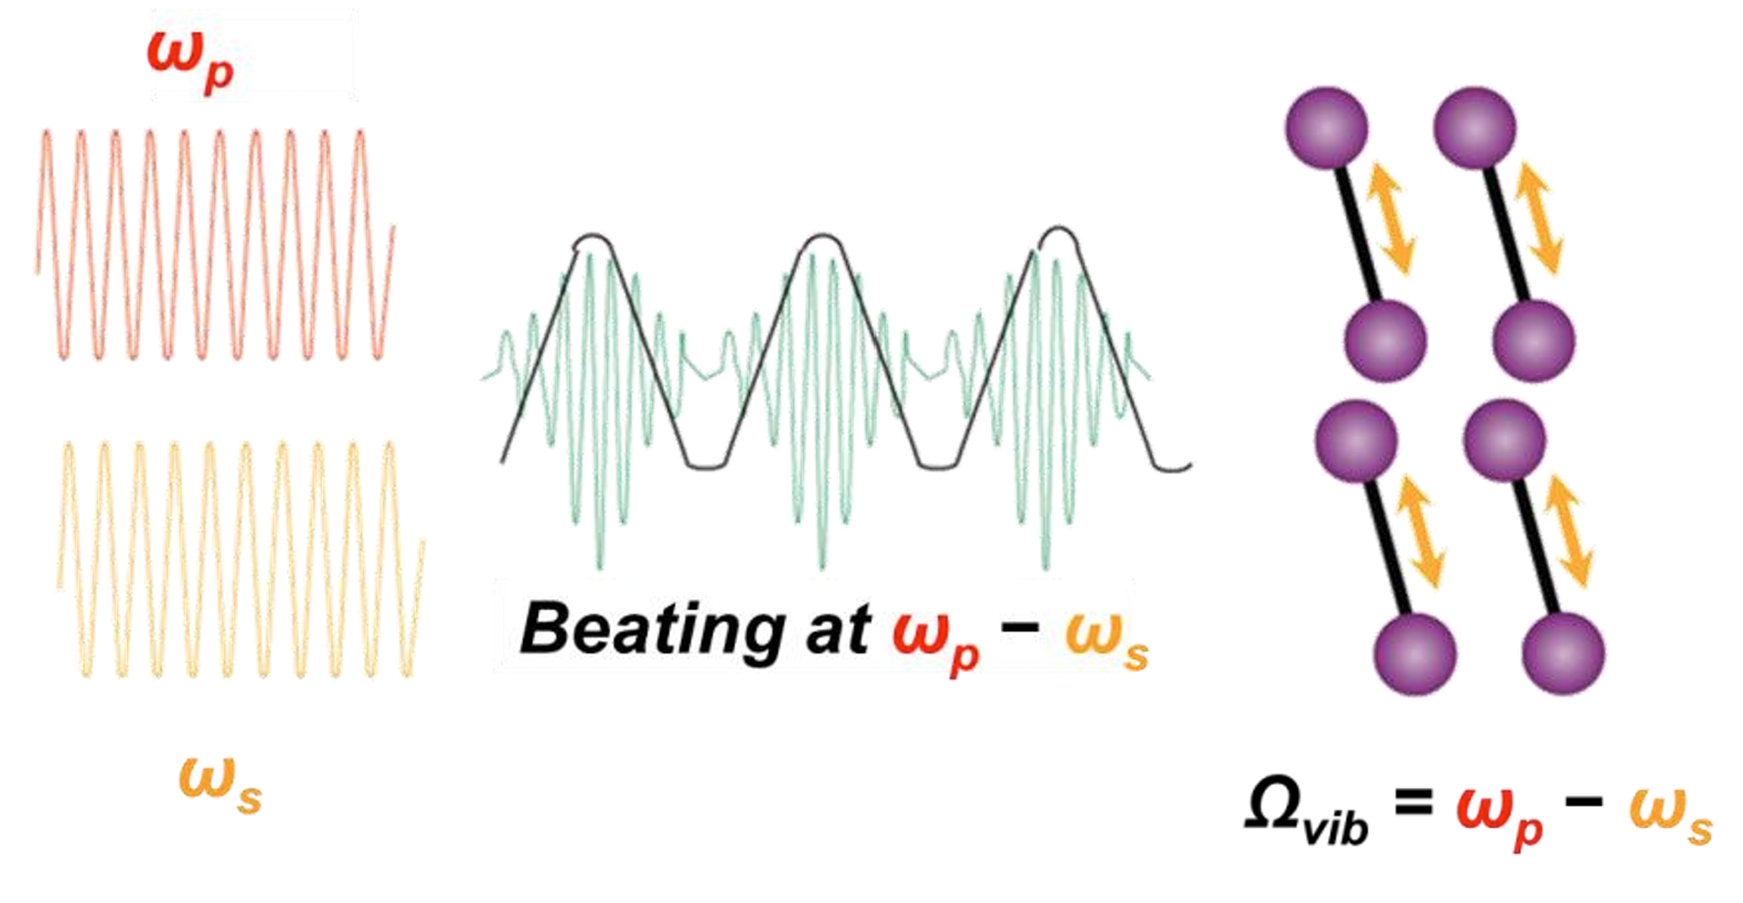
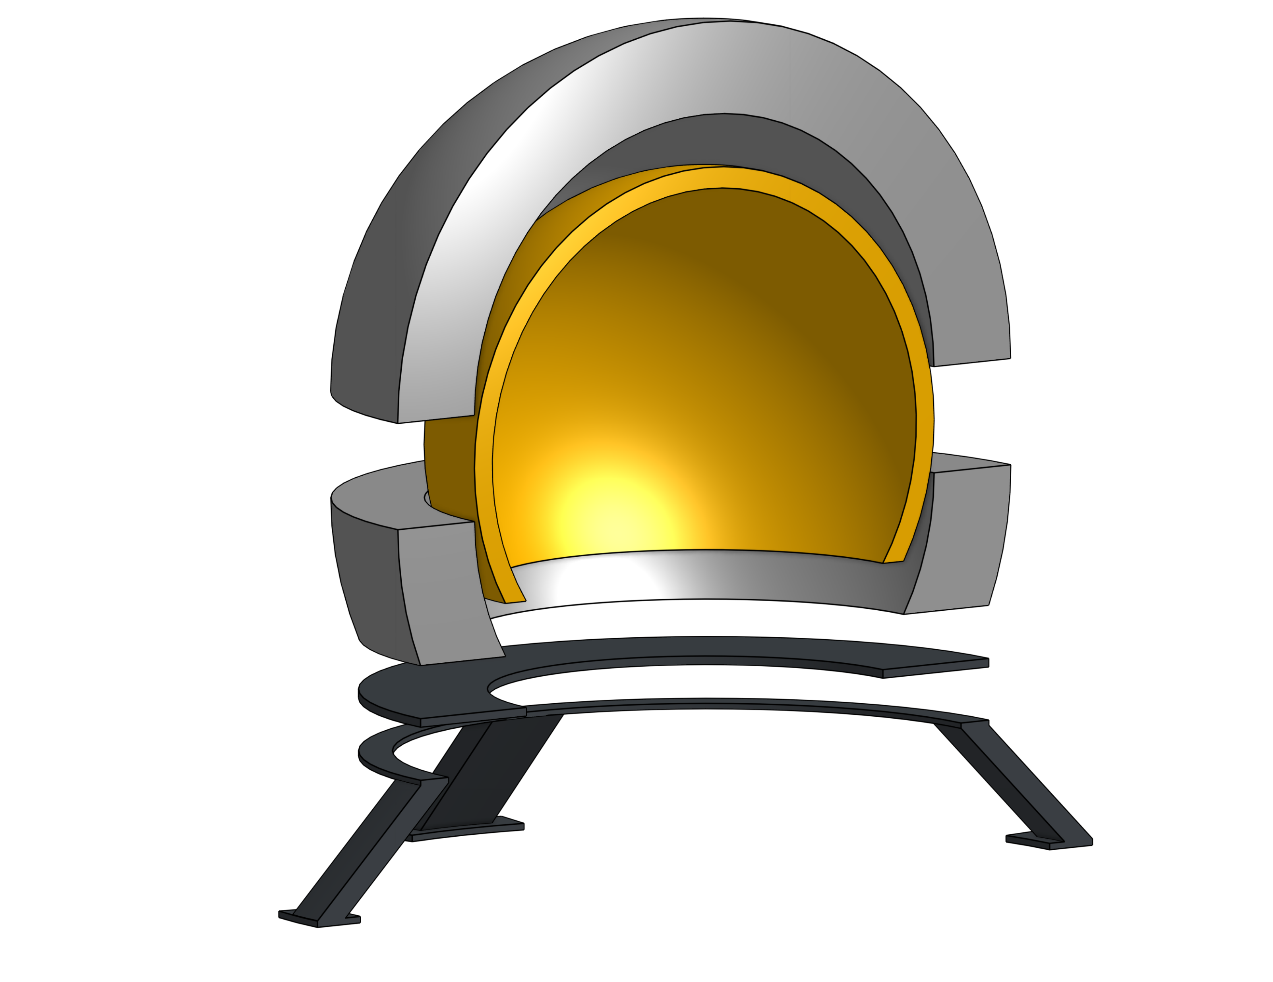
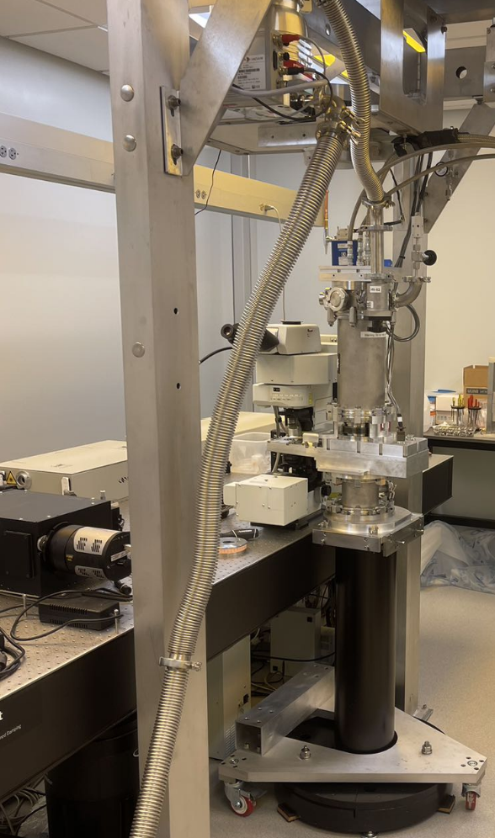
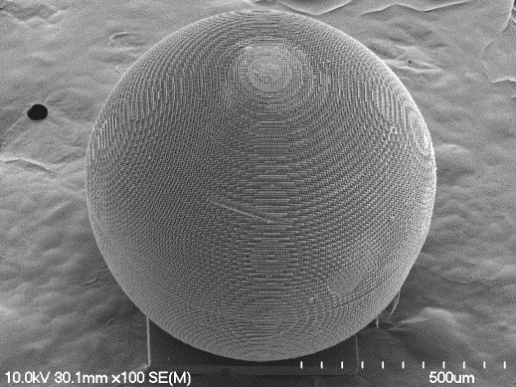
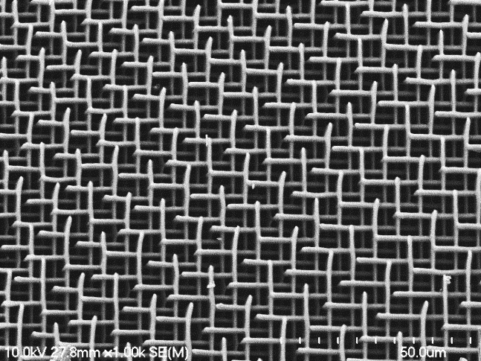
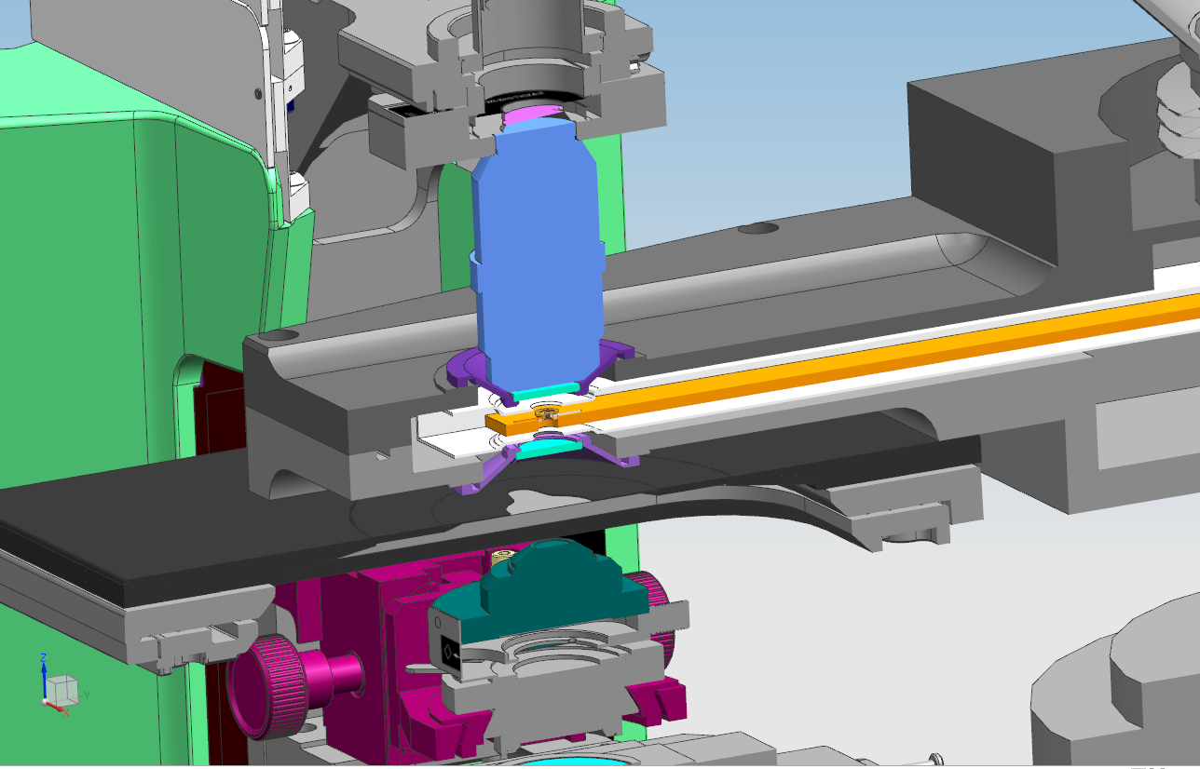
LASER ASSISTED
NANO ENGINEERING LAB (LANE)
Layer-by-Layer Defect Diagnostics in Two-Photon Polymerization Fusion Targets via Coherent Anti-Stokes Raman Scattering Microscopy
Zachary Schuder, Casey Frantz, Xi Huang1, Aofei Mao¹, Peizi Li¹, Sarah M. Fess², Mark Bonino², Dale Guy², Dustin Floura², David R. Harding², and Yongfeng Lu^{1,*}
¹Department of Electrical and Computer Engineering, University of Nebraska-Lincoln (UNL), NE 68588
²University of Rochester-Laboratory for Laser Energetics (LLE), Rochester, NY 14623
*Email: ylu2@unl.edu
Motivation and Challenges
Target Diagnostics
Spherical fuel capsule filled with deuterium-tritium (D-T) is struck by high-powered lasers from all sides to compress the capsule uniformly to extreme temperatures and pressures — triggering nuclear fusion.
Target quality is paramount: Microscale deviations in symmetry or material properties can lead to hydrodynamic instabilities during compression — leading to energy loss and preventing ignition.
Because fusion targets are so small and fragile, and because you only get one shot, it's crucial to analyze and qualify pre-implosion diagnostics of targets before use.
3D CARS imaging and 3D reconstruction for target diagnosis
Cryo-CARS imaging of D₂ ice at 12 K
TPEF
CARS
Challenges
CD shell
D₂ ice
Surface scratches
Merged
Merged
Defect diagnosis
3D survey of defects using GPS-like coordinates (r, θ, z)
θ= 4.1º
θ= -28.7º
θ= -34.1º
D₂ ice cracks
Resolution < 1 µm
r= 194.6 µm
r= 151.4 µm
r= 197.2 µm
z= 48.8 µm
z= 758.4 µm
z= 761.6 µm
3D reconstruction of D₂ ice
r
D₂ ice
Distribution of fuel ice
z
θ
Defect on the surface of outer shell wall
Defect inside the shell wall
Defect on the surface of inner shell wall
Coherent Anti-Stokes Raman (CARS)
Target Fabrication
Focus on diagostics and defects
Move tpp section to bottom right
Fundamentals of CARS in bottom left
Experimental results in top right
Two synchronized pulsed lasers (Pump beam + Stokes beam) Frequency difference matches molecular vibration
Coherently excites molecules, producing strong anti-Stokes signal
Nonlinear process
Signal only forms where beams overlap
Fast, 3D chemical imaging to identify voids, defects, and fuel layering.
Utilized two-photon polymerization to solidify liquid resin, building intricate geometries layer by layer.
Achieving superior uniformity is critical to enhance mechanical robustness, reduce defects, and improve overall target performance for high-yield fusion.
ω_{pump}
ω_{pump}
ω_{Stokes}
Excited
state
ν₁
ω_{anti-Stokes}
ν₀
Ground
state
UV
Near-IR
Model (STL)
Fs Laser
Resin (IP-S)
3D Printing (TPP)
Substrate (ITO)
Shell
Foam
Foam target
Up to
mm-sizes
Microscale pores
Nanoscale filaments
Final Product
CARS microscopy
cryostat
Acknowledgment
D₂-loaded targets at 12-20 K
This material is based upon work supported by the Department of Energy National Nuclear Security Administration University of Rochester “National Inertial Confinement Fusion Program” under Award Number DE-NA0004144.

